Slide 1

Chapter 10
Error Detection
and
Correction
10.
Copyright © The McGraw-Hill Companies, Inc. Permission required for reproduction or display.

Slide 2

Note
The Hamming distance between two words is the number of differences between corresponding bits.
10.

Slide 3

Example 10.4
Let us find the Hamming distance between two pairs of words.
1. The Hamming distance d(000, 011) is 2 because
2. The Hamming distance d(10101, 11110) is 3 because
10.

Slide 4
Note
The minimum Hamming distance is the smallest Hamming distance between
all possible pairs in a set of words.
10.

Slide 5
Example 10.5
Find the minimum Hamming distance of the coding scheme in Table 10.1.
Solution
We first find all Hamming distances.
The d_{min} in this case is 2.
10.

Slide 6
Example 10.6
Find the minimum Hamming distance of the coding scheme in Table 10.2.
Solution
We first find all the Hamming distances.
The d_{min} in this case is 3.
10.

Slide 7
Note
A simple parity-check code can detect an odd number of errors.
10.

Slide 8
10-4 CYCLIC CODES
Cyclic codes are special linear block codes with one extra property. In a cyclic code, if a codeword is cyclically shifted (rotated), the result is another codeword.
Topics discussed in this section:
Cyclic Redundancy Check
Hardware Implementation
Polynomials
Cyclic Code Analysis
Advantages of Cyclic Codes
Other Cyclic Codes
10.

Slide 9

Table 10.6 A CRC code with C(7, 4)
10.

Slide 10

Figure 10.14 CRC encoder and decoder
10.

Slide 11

Figure 10.15 Division in CRC encoder
10.

Slide 12

Figure 10.16 Division in the CRC decoder for two cases
10.

Slide 13
Using Polynomials
We can use a polynomial to represent a binary word.
Each bit from right to left is mapped onto a power term.
The rightmost bit represents the “0” power term. The bit next to it the “1” power term, etc.
If the bit is of value zero, the power term is deleted from the expression.

Slide 14

Figure 10.21 A polynomial to represent a binary word
10.

Slide 15

Figure 10.22 CRC division using polynomials
10.

Slide 16
Example 10.17
Find the suitability of the following generators in relation to burst errors of different lengths.
a. x⁶ + 1 b. x¹⁸ + x⁷ + x + 1 c. x³² + x²³ + x⁷ + 1
Solution
a. This generator can detect all burst errors with a length
less than or equal to 6 bits; 3 out of 100 burst errors
with length 7 will slip by; 16 out of 1000 burst errors of
length 8 or more will slip by.
10.

Slide 17
Example 10.17 (continued)
b. This generator can detect all burst errors with a length
less than or equal to 18 bits; 8 out of 1 million burst
errors with length 19 will slip by; 4 out of 1 million
burst errors of length 20 or more will slip by.
c. This generator can detect all burst errors with a length
less than or equal to 32 bits; 5 out of 10 billion burst
errors with length 33 will slip by; 3 out of 10 billion
burst errors of length 34 or more will slip by.
10.

Slide 18
Note
A good polynomial generator needs to have the following characteristics:
1. It should have at least two terms.
2. The coefficient of the term x⁰ should
be 1.
3. It should not divide x^{t} + 1, for t
between 2 and n − 1.
4. It should have the factor x + 1.
10.

Slide 19
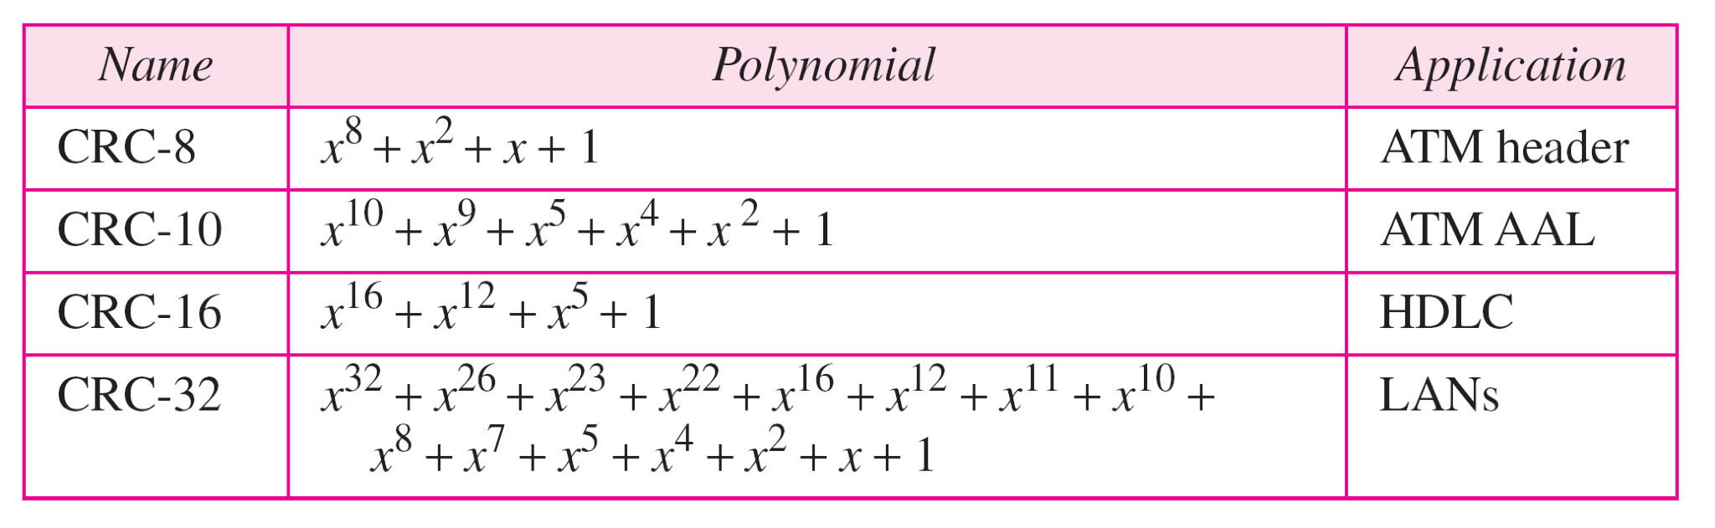
Table 10.7 Standard polynomials
10.

